Slide 1
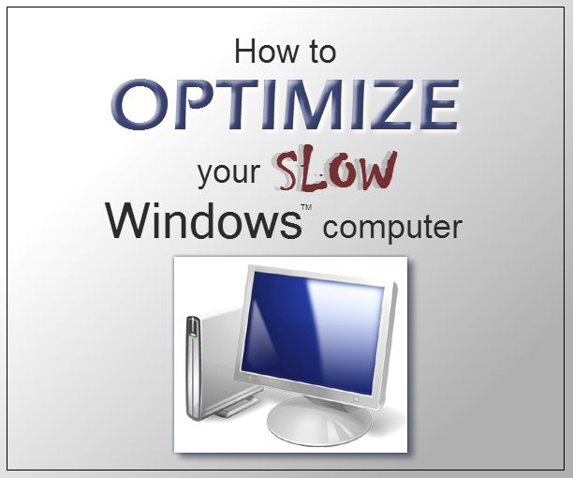
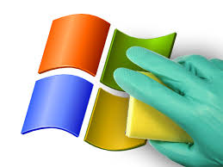

Optimize the Computer

Slide 2
What is windows update
Microsoft Update is a service from Microsoft that delivers updates for Microsoft Windows, Microsoft Office, and other Microsoft programs
Updates often include downloads that can help to keep your computer secure.

Slide 3
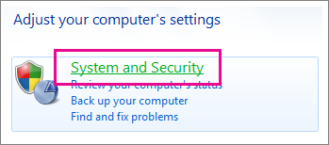
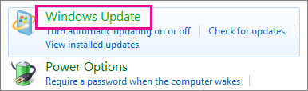
  Use Windows Update
Close all open programs.
Click Start > Control Panel.
Click System and Security (which you see when you view Control Panel by Category).
Click Windows Update.
In the left-hand pane, click Change Settings.
Under Important Updates, select Install updates automatically.

Slide 4
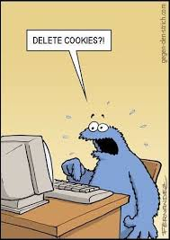
Clean temporary Internet File and Cookies

Slide 5
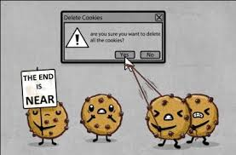
cookies
Cookies are small text files that Web sites put on your computer to store a variety of information about you or your preferences. Some Web sites store your user name and password
If you delete a cookie, you might need to enter this information again the next time you visit the Web site.

Slide 6
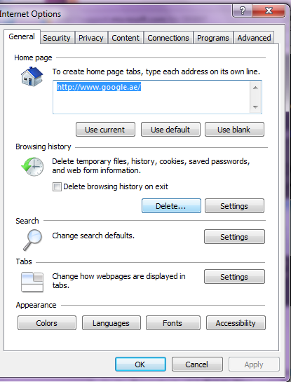
To delete cookie
To delete all cookies
In Internet Explorer, on the Tools menu, click Internet Options.
On the General tab, click Delete Cookies.

Slide 7
