Slide 1
State of Matters
Solid
Liquid
Gas

Slide 2

Solid

Slide 3
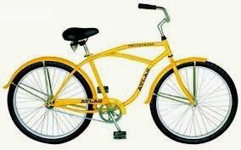
Solid

Slide 4
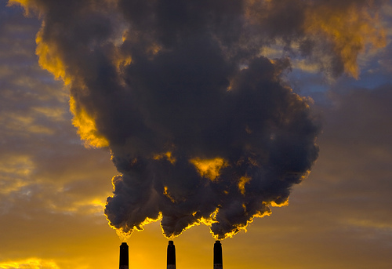
Gas

Slide 5
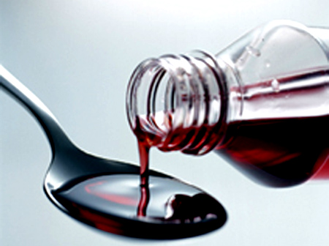
Liquid

Slide 6
